Slide 1


Kongu Engineering College
IOT MINI PROJECT
IOT Based Home Automation
Using Telegram Bot
Project by
1. 20CSR145-PAVITHRA J
2. 20CSR154-PRIYA R
3. 20CSR157-PRIYADHARSHINI S
Notes:
8/25/20
1-23

Slide 2
Aim
The aim is to automate all the Fan in a house using a telegram bot.
7/27/2023

Slide 3
Scope of the proposed project
The appliances in the house are accessed that is on/off process is done using the switches connected to that devices.
This project helps us to access these appliances using a mobile phone with a help of python.

Slide 4
Design Methodology
Step 1: The microcontroller is fed with the python code to access the devices.
Step 2: The user provides an input using the telegram bot created using the telegram.
Step 3: The response to the corresponding button is sent to the microcontroller.
Step 4: Based on the request the corresponding on/off process is carried out by the microcontroller.

Slide 5
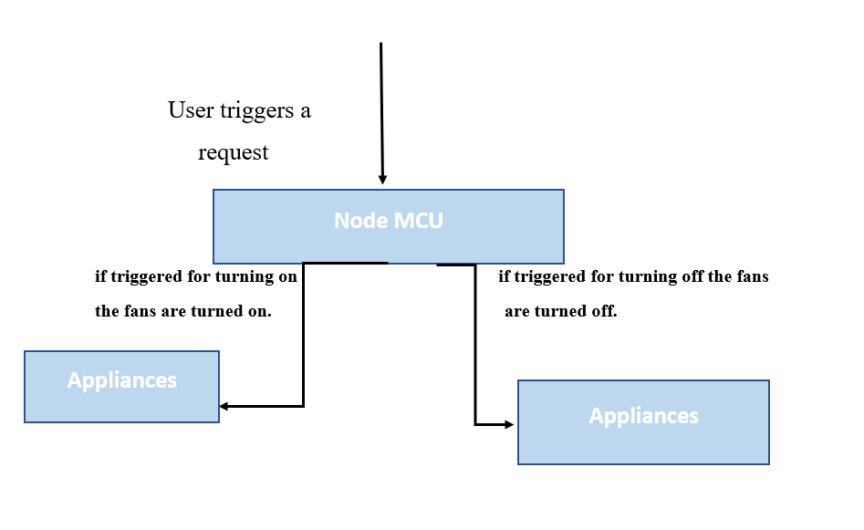
WORK FLOW

Slide 6
Component Used
• Node MCU
• 4 Channel relay
• Jumper wires
• Fan
• Wires
• Micro USB cable

Slide 7
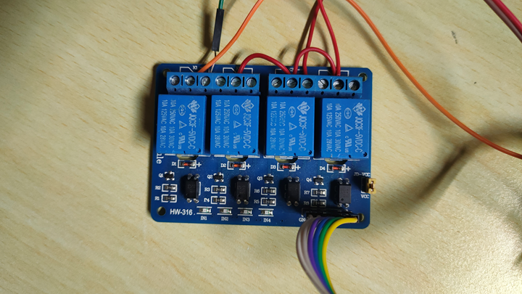
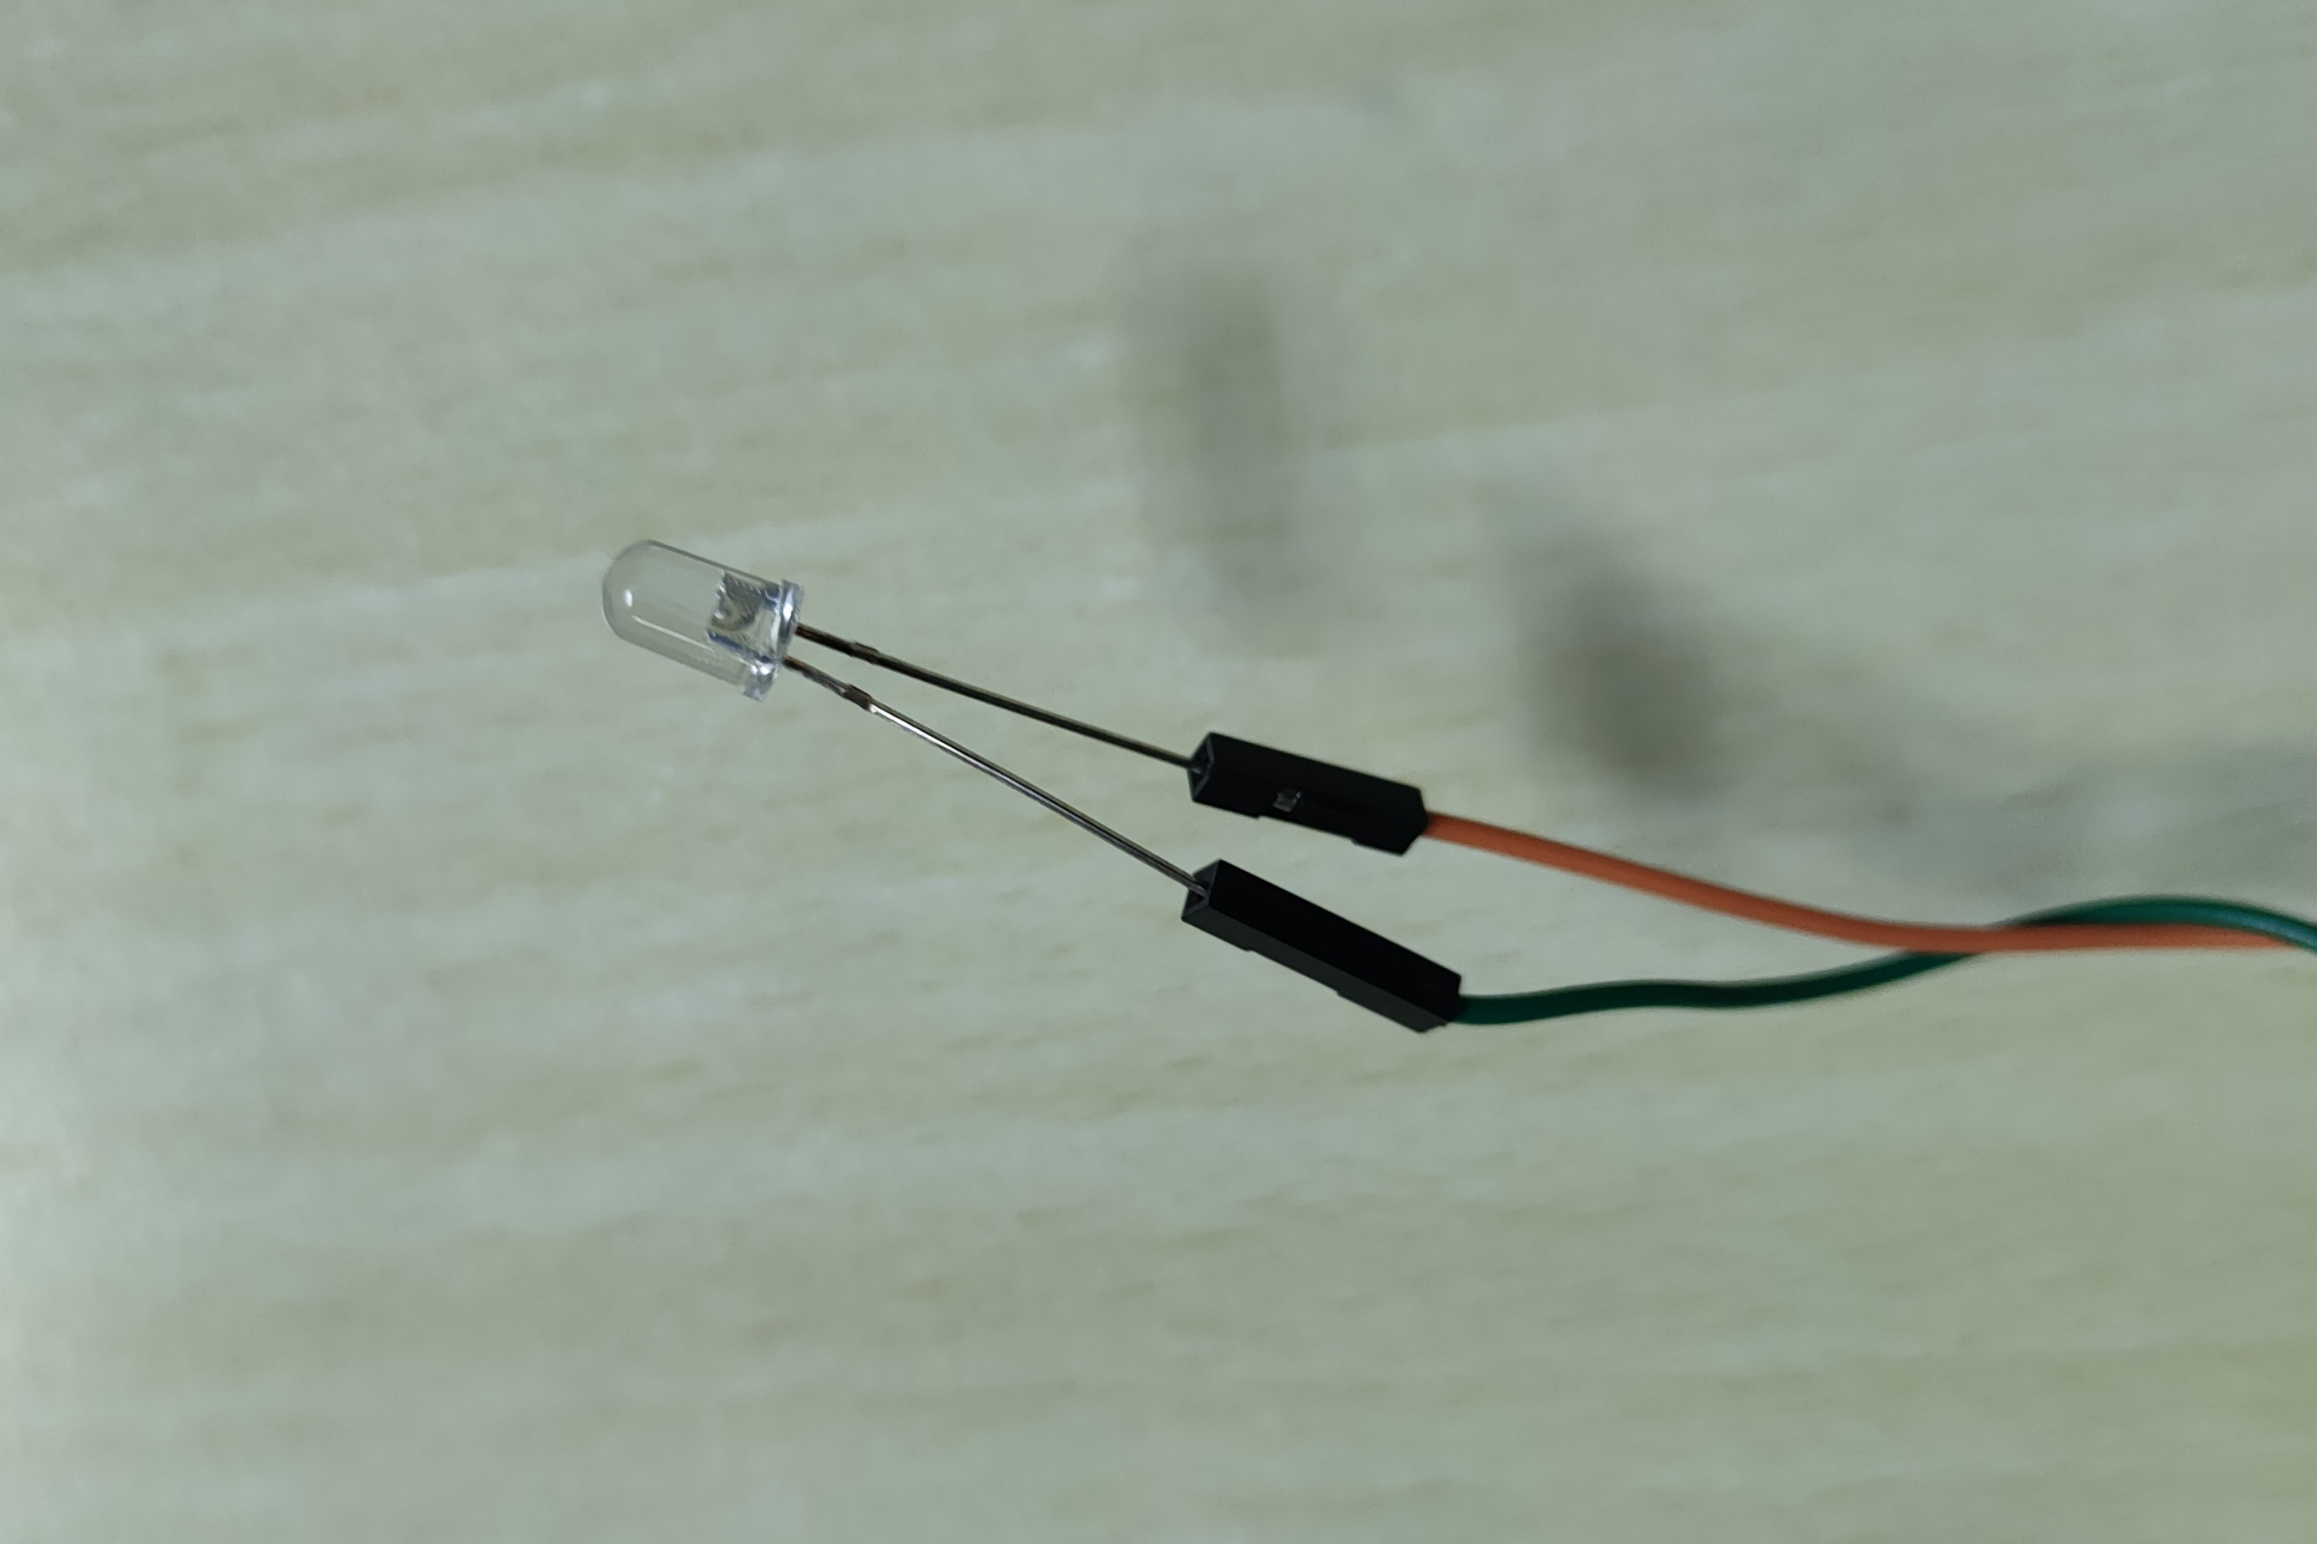
OUTPUT SNAPSHOT

Slide 8
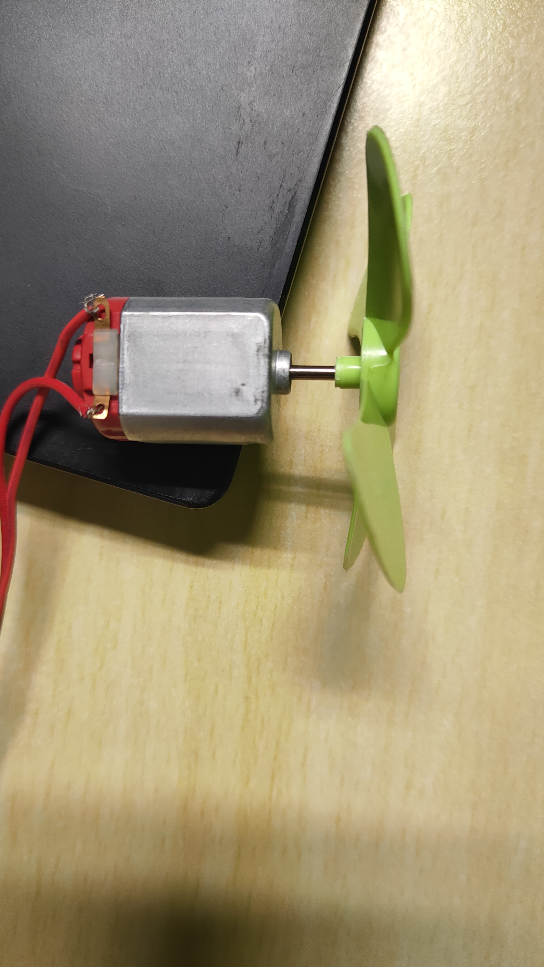
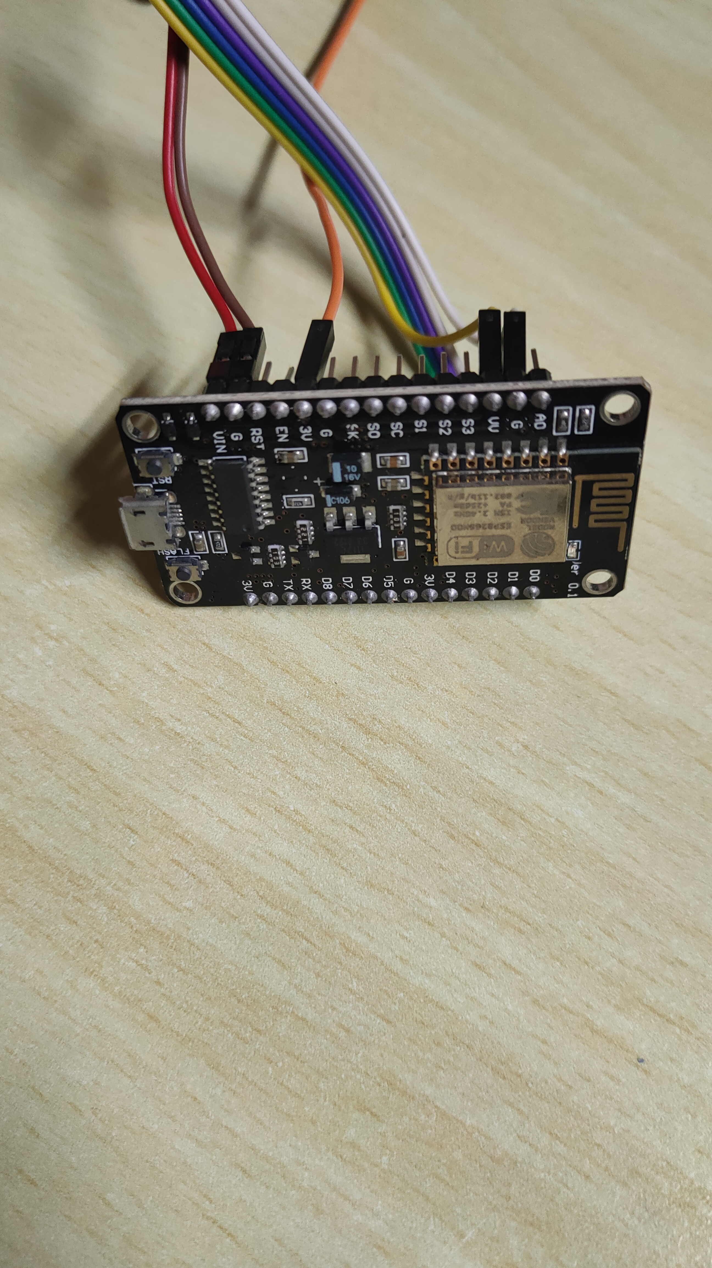
OUTPUT SNAPSHOT

Slide 9
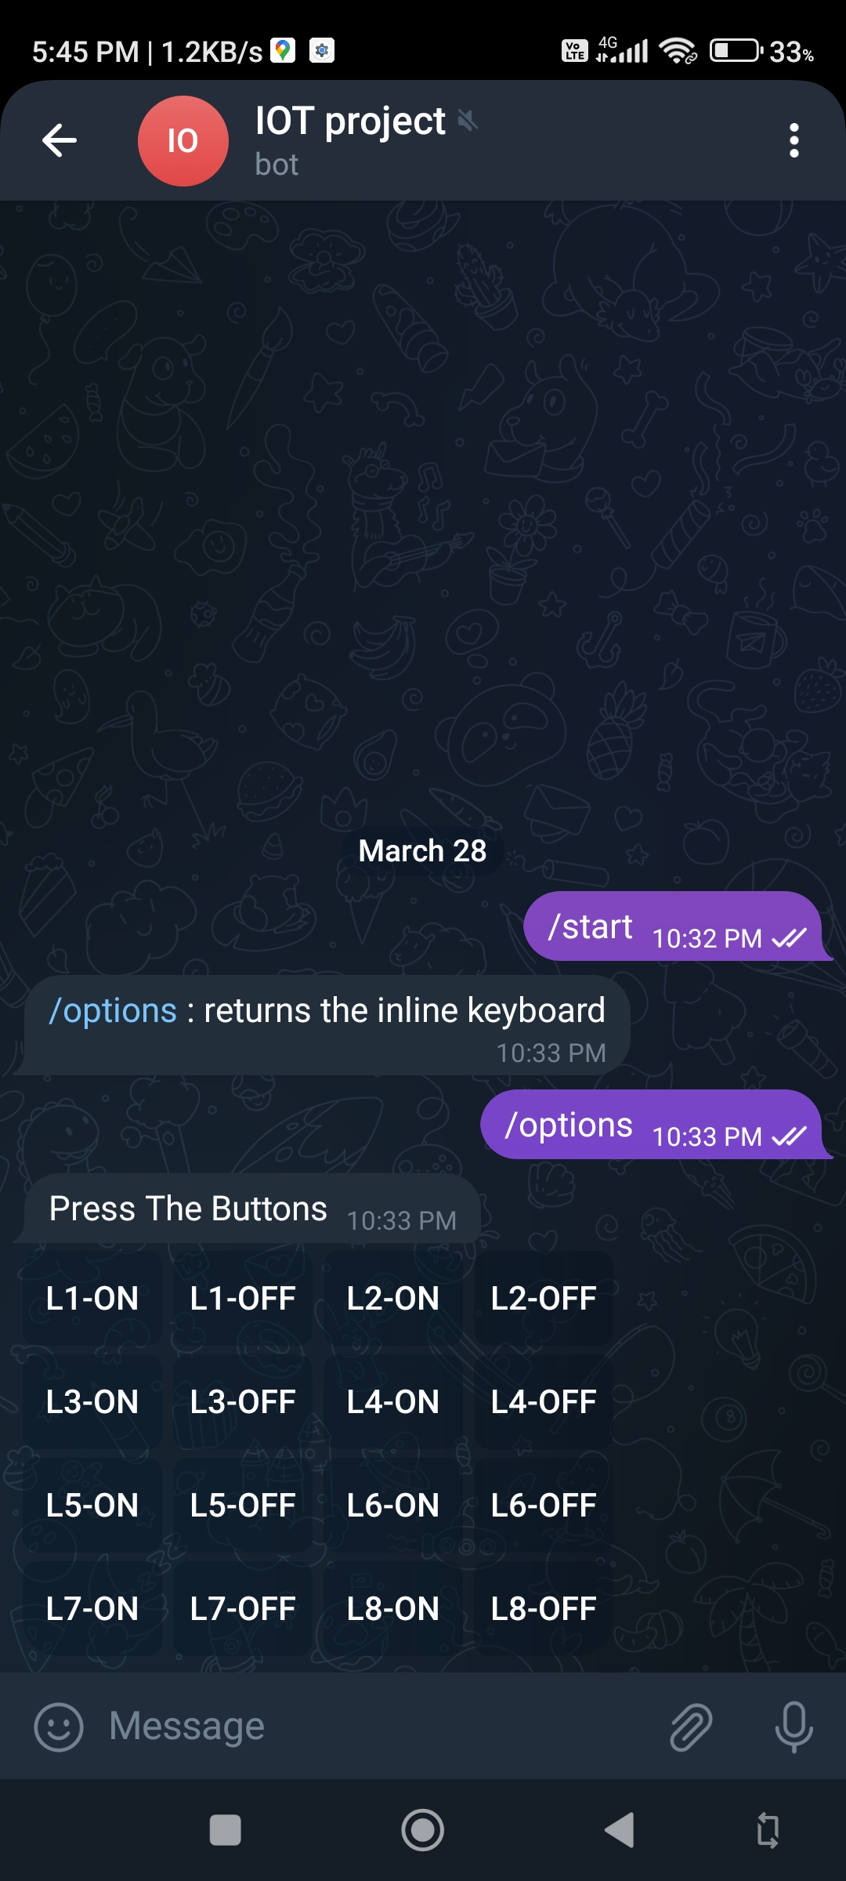
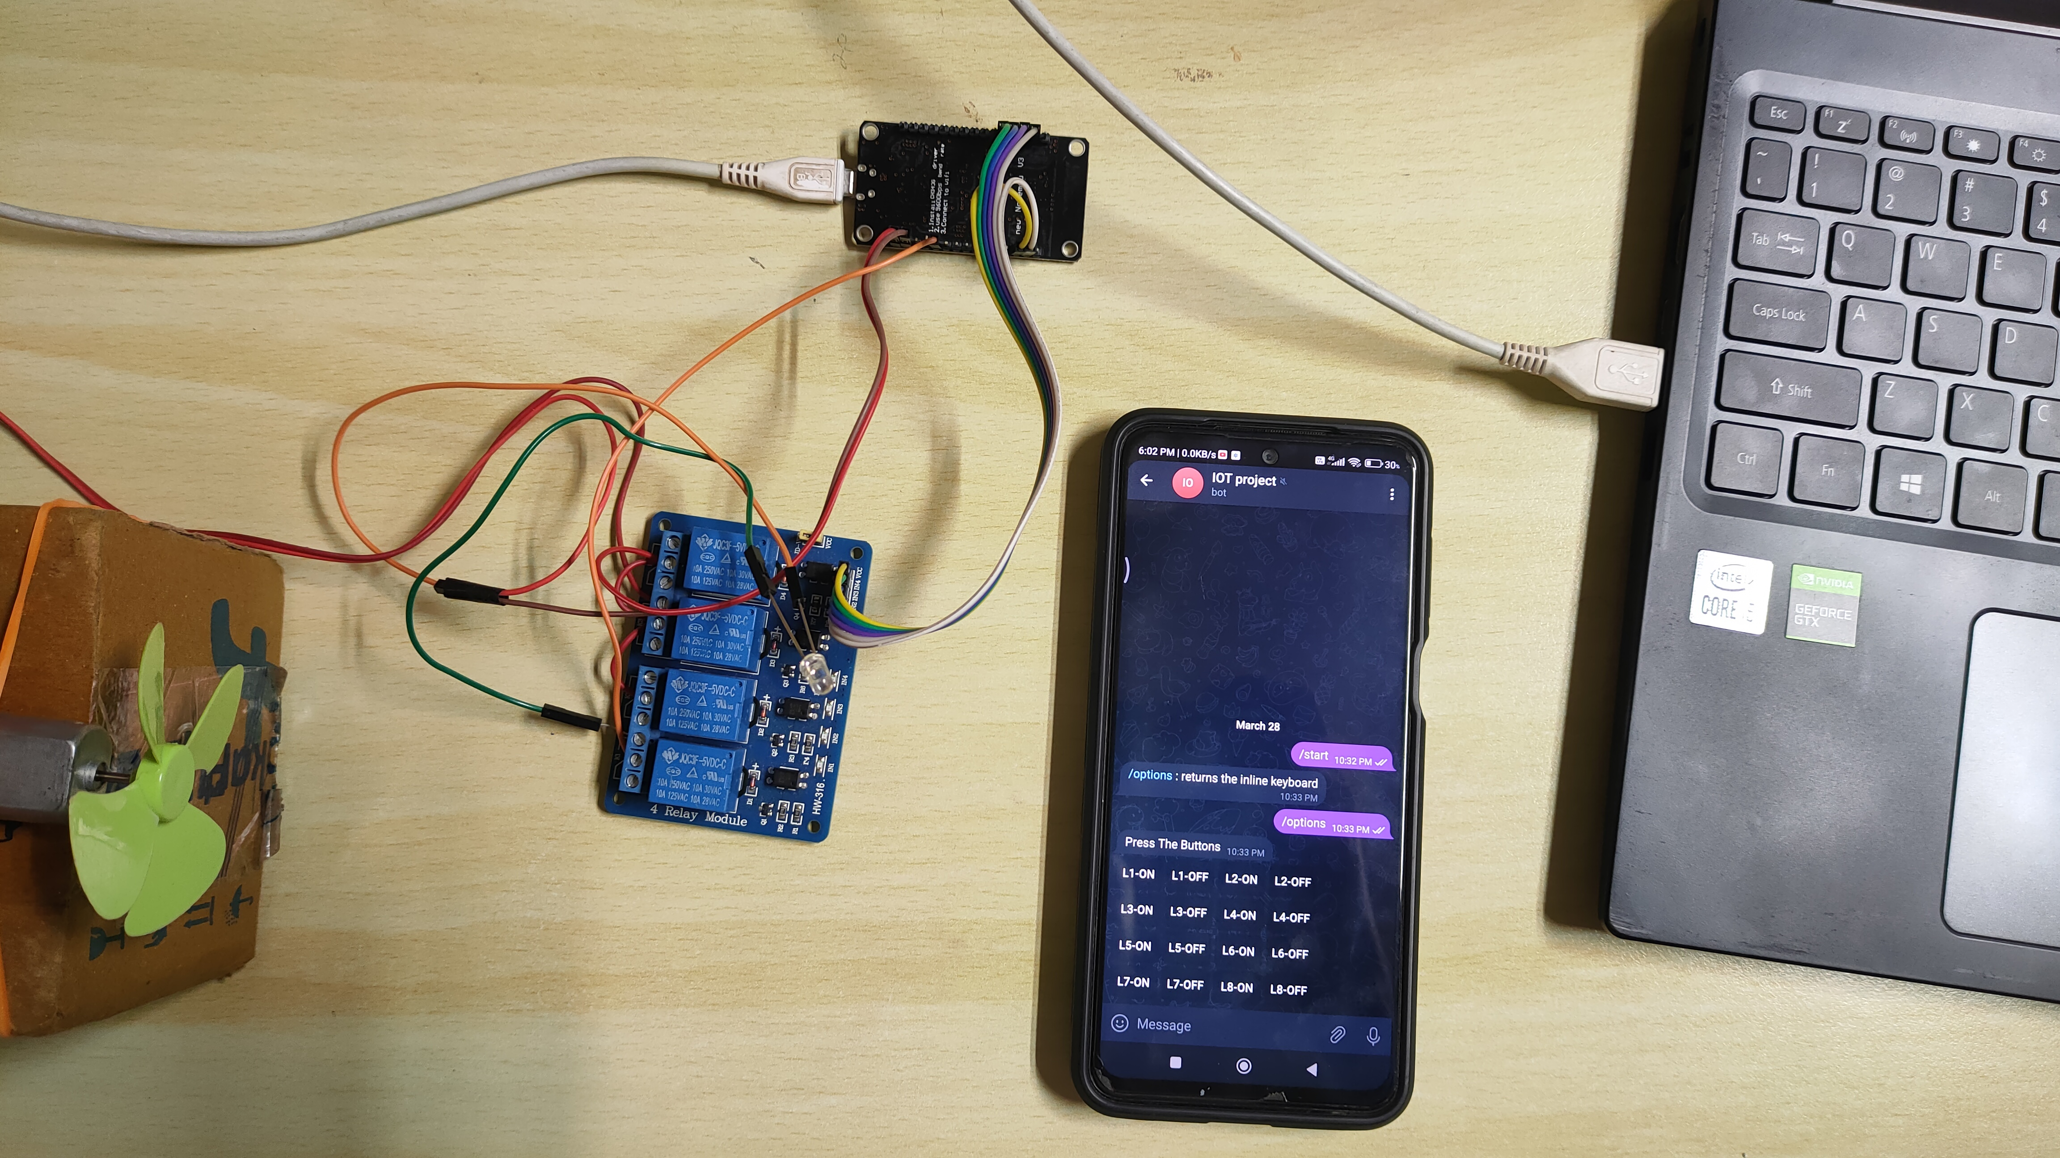
OUTPUT SNAPSHOT

Slide 10
Conclusion
With this project, we achieved the automation of devices and
accessibility of devices in a place from anywhere in the world.

Slide 11
_{THANK YOU}

